Slide 1
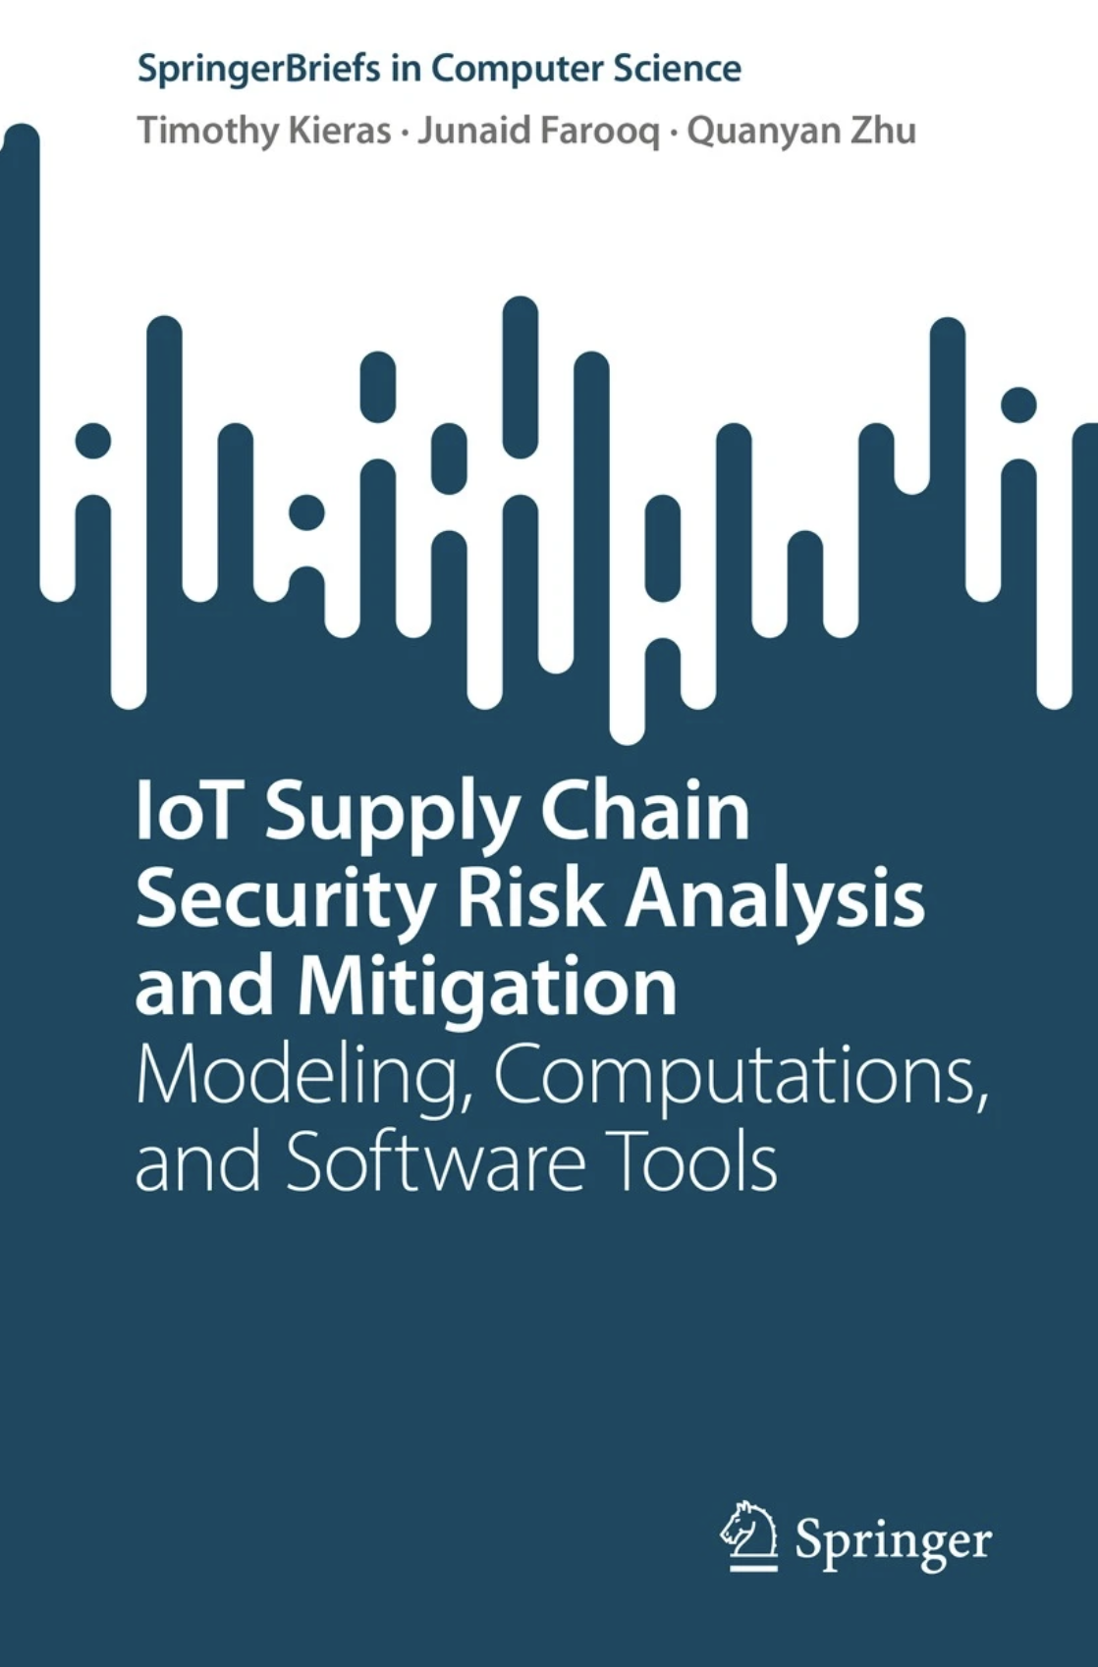
The specific topics in this book include:
Risk modeling and analysis of IoT supply chains
Methodologies for risk mitigation, policy management, accountability, and cyber insurance
Tutorial on a software tool for supply chain risk management of IoT
These topics are supported by up-to-date summaries of the authors’ recent research findings. The authors introduce a taxonomy of supply chain security and discusses the future challenges and directions in securing the supply chains of IoT systems. It also focuses on the need for joint policy and technical solutions to counter the emerging risks, where technology should inform policy and policy should regulate technology development.

Slide 2
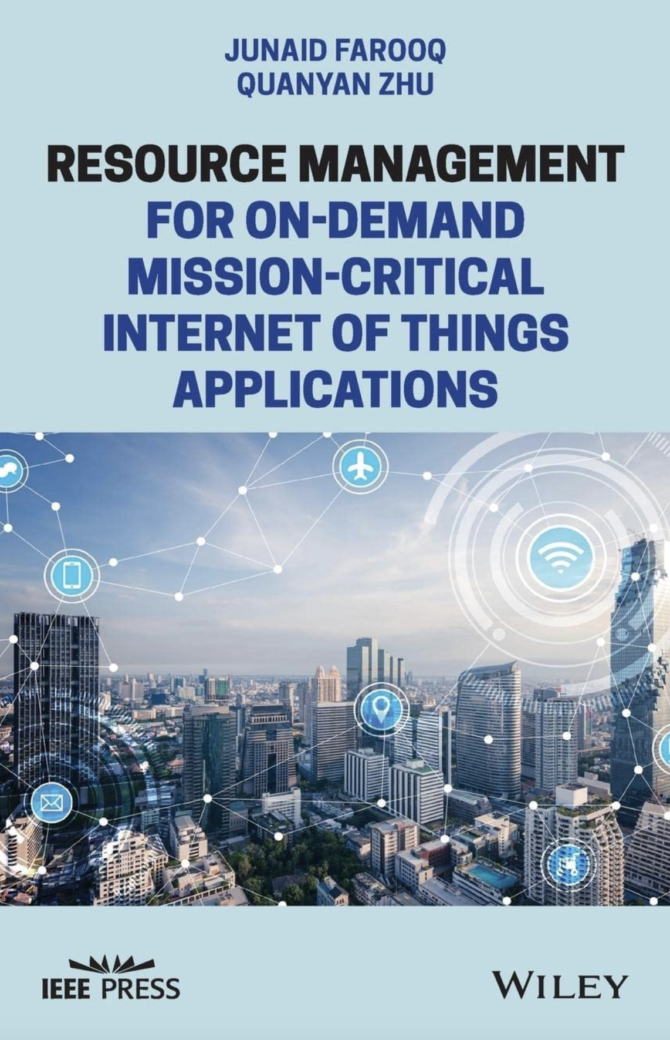
The book offers an economic perspective on resource management in IoT systems with a particular emphasis on three main areas: spectrum management via reservation, allocation of cloud/fog resources to IoT applications, and resource provisioning to smart city service requests. It leverages theories from dynamic mechanism design, optimal control theory, and spatial point processes, providing an overview of integrated decision-making frameworks.
Readers will also enjoy the inclusion of:
A thorough introduction and overview of IoT applications in smart cities, mission critical IoT services and requirements, and key metrics and research challenges
A comprehensive exploration of the allocation of spectrum resources to mission critical IoT applications, including the massive surge of IoT and spectrum scarcity problem
Practical discussions of the provisioning of cloud/fog computing resources to IoT applications, including allocation policy
In-depth examinations of resource provisioning to spatio-temporal service requests in smart cities
Perfect for engineers working on Internet of Things and cyber-physical systems, Resource Management for On-Demand Mission-Critical Internet of Things Applications is also an indispensable reference for graduate students, researchers, and professors with an interest in IoT resource management.

